Slide 1


Oidhche Nollaig
Notes:
Christmas Eve

Slide 2

’S e Oidhche Nollaig a th’ ann.
Notes:
It’s Christmas Eve.

Slide 3
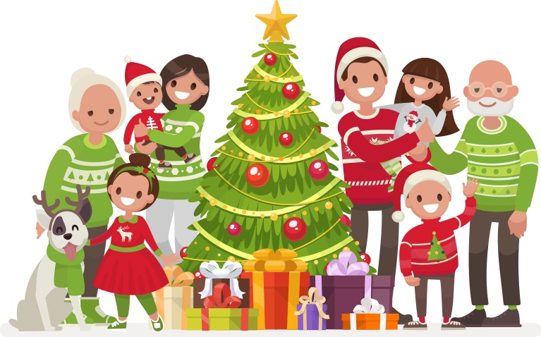
Tha sinn uile air bhioran.
Notes:
All of us are excited.

Slide 4
Bidh Bodach na Nollaig a’ tighinn a-nochd!
Notes:
Father Christmas will be coming tonight.

Slide 5
Bidh còta dearg is bòtannan dubha air agus bidh baga mòr aige.
Notes:
He will have a red coat and black boots on and he will have a big bag (sack).

Slide 6

Bidh preusantan anns a’ bhaga mhòr.
Notes:
Presents will be in the big bag (sack).

Slide 7
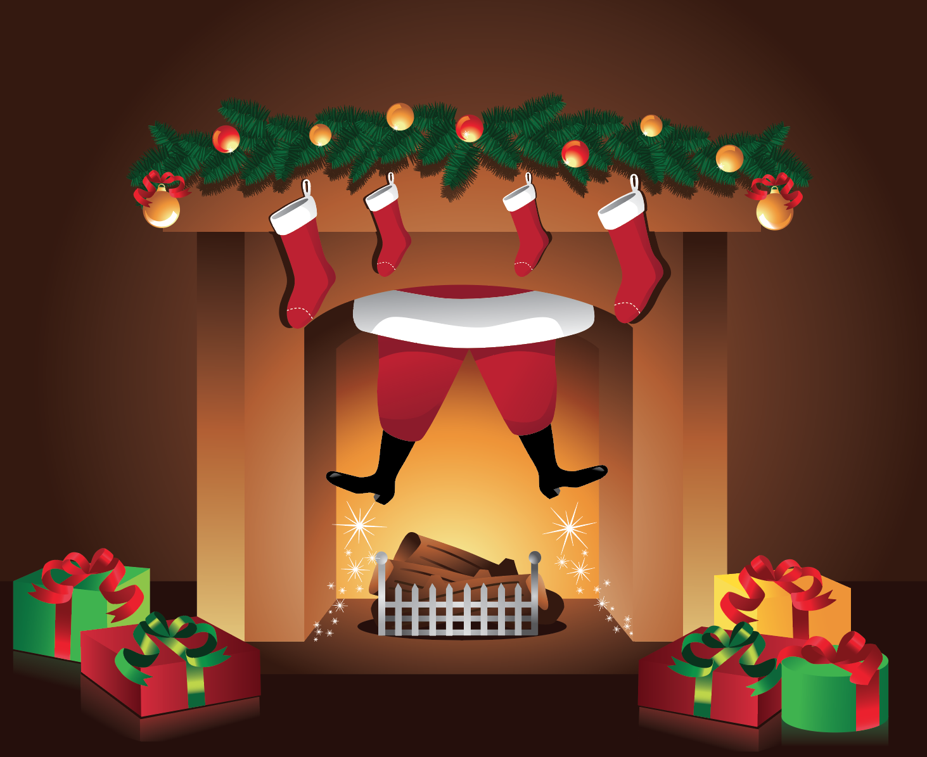
Thig e sìos an similear agus cuiridh e na preusantan ri taobh an teine.
Notes:
He will come down the chimney and he will put the presents beside the fire.

Slide 8
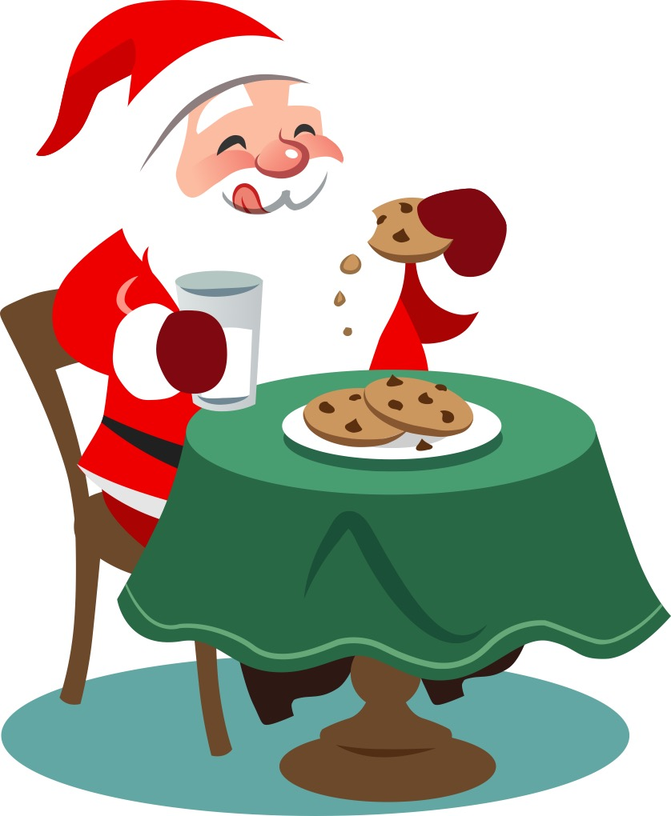
Òlaidh e am bainne agus ithidh e na briosgaidean.
Notes:
He will drink the milk and he will eat the biscuits.

Slide 9
Cuiridh e na currain na phòcaid agus bheir e iad do Rudolf nuair a thèid e a-mach a-rithist.
Notes:
He will put the carrots in his pocket and give them to Rudolph when he comes back outside.

Slide 10
Tha sinn an dòchas gun caidil sinn
gu math a-nochd.
Notes:
We hope that we sleep well tonight.

Slide 11
Èiridh sinn a-màireach agus bidh sinn uile cho toilichte.
Notes:
We will get up tomorrow and we will all be so happy.

Slide 12
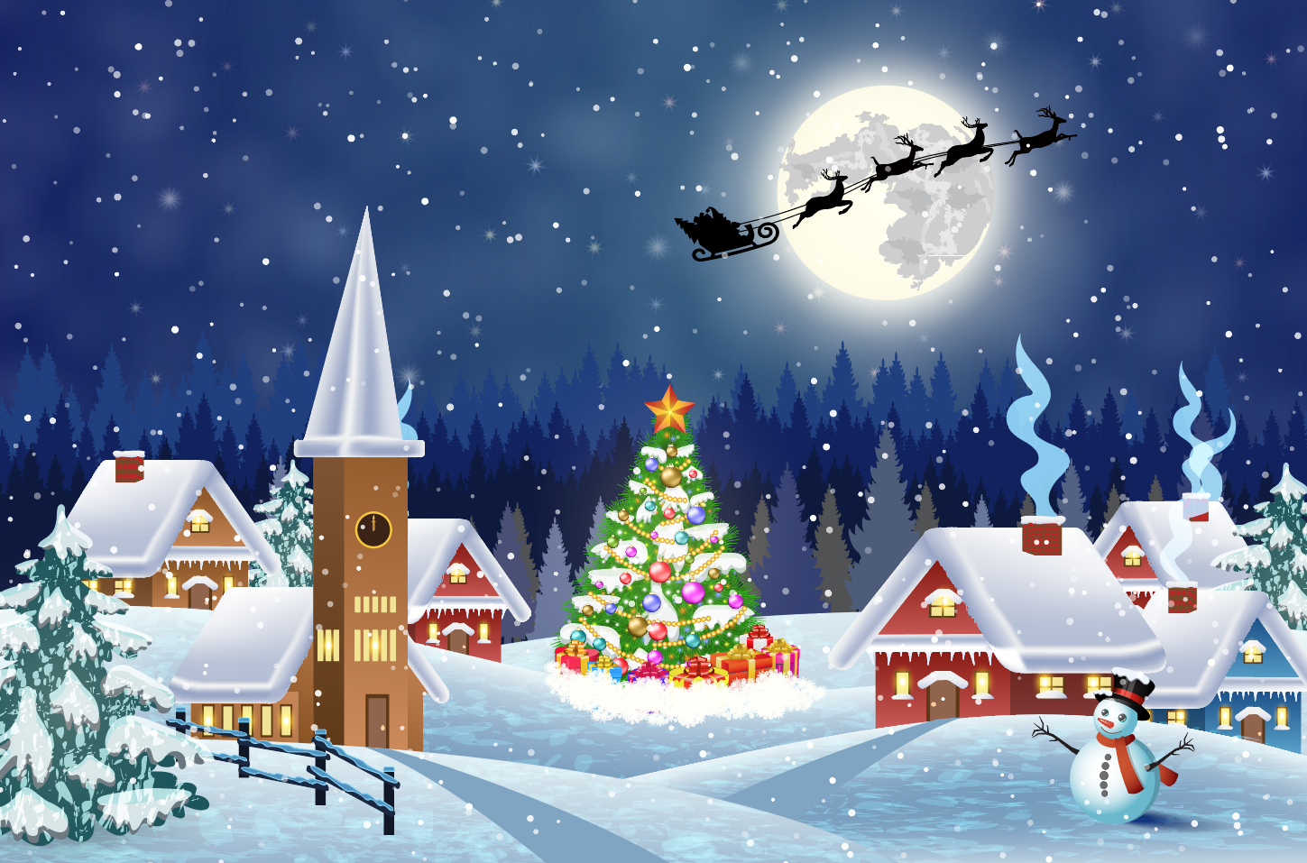
Nollaig Chridheil dhuibh uile!
Notes:
Merry Christmas to you all!

